Slide 1

Self – Information Management
FSIM2012

Slide 2

Member
Lại Lê Lệ Linh
Lê Thị Minh Khánh
Nguyễn Thị Gấm
Nguyễn Đức Lộc
Nguyễn Anh Tuấn
Technology
Time
2 members work full-time
2 members can spend full-time for capstone project
1 member have to study in Fall semester
(block 1-2: slot 2,3,5 and block 3-4: slot 3)
1 member is studying about Android
1 member knows about Window application on Window 8

Slide 3
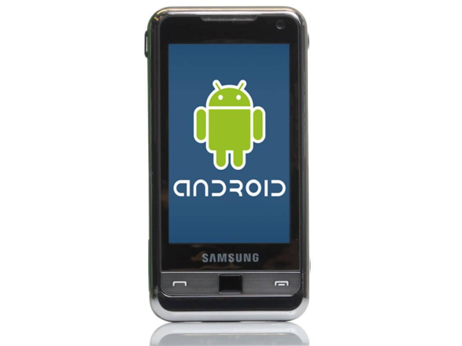
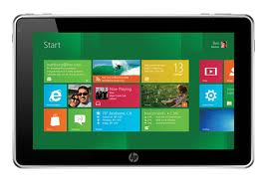
SIM2012
English name:
Self – Information Management
Vietnamese name:
Phần mềm quản lí thông tin cá nhân
Abbreviation: SIM2012
Product:
Android Mobile
Window application on window 8 (for tablet)

Slide 4





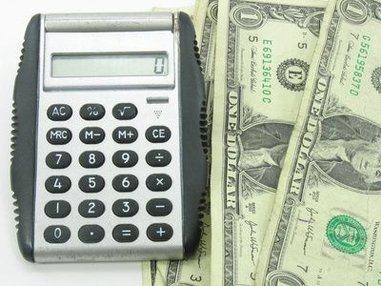


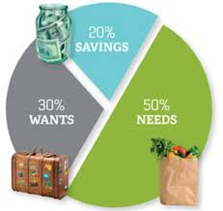
SIM2012
Function
Synchronize data
Make a warning for user
Borrowing and lending money management
Expenditure management
Schedule for expenditure
Schedule for expenditure
Expenditure management
Borrowing and lending money management
Report at the end of month
Make a warning for user
Synchronize data
Report at the end of month

Slide 5
Environment
Mail group: fsim2012@googlegroups.com
SVN: http://code.google.com/p/fsim2012/
Coding:
_ OS: Window 8/ Window 7
_ Visual Studio 2012
_ Eclip IDE for Java Developers
_ Android SDK 2.3

Slide 6
Thank You !

